Slide 1

ValoStats
Your Ultimate gambling analytics partner

Slide 2
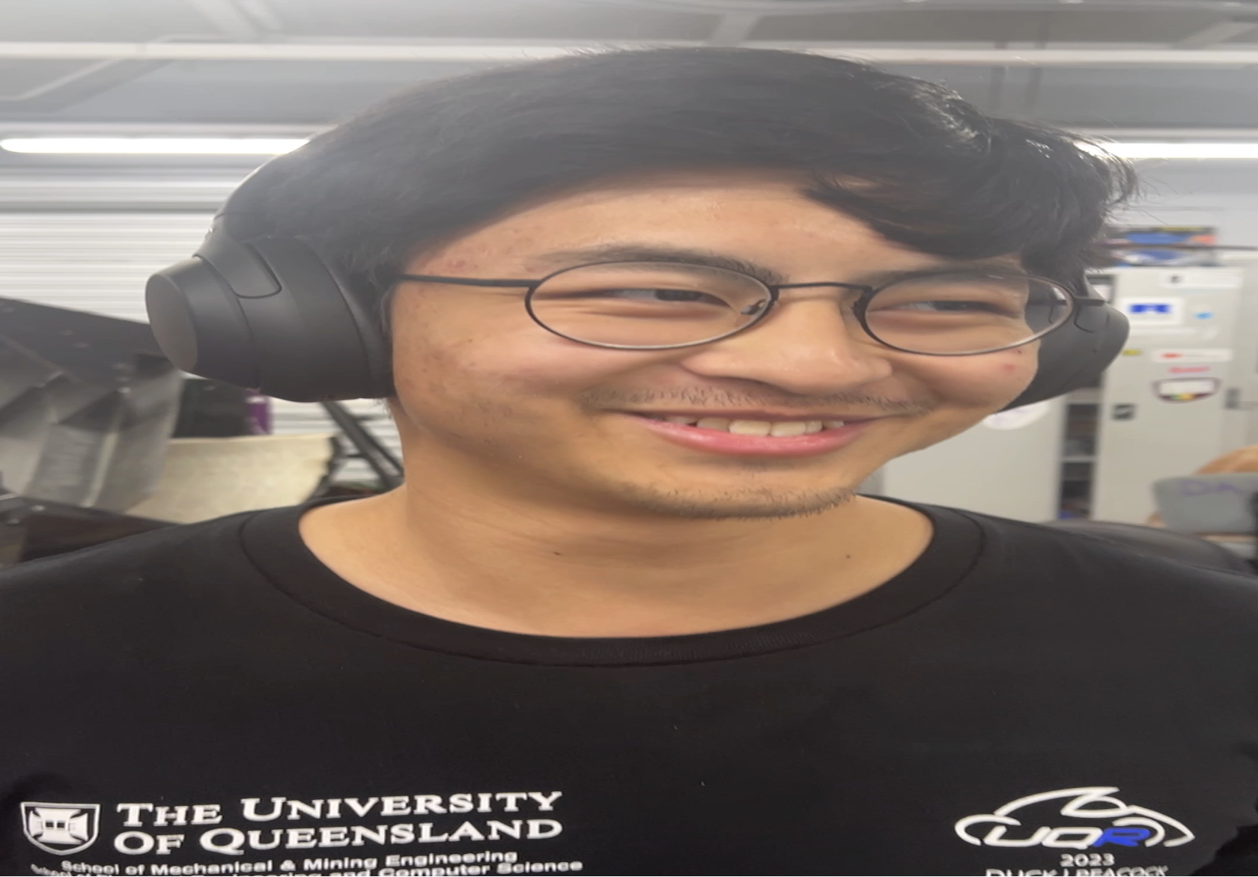
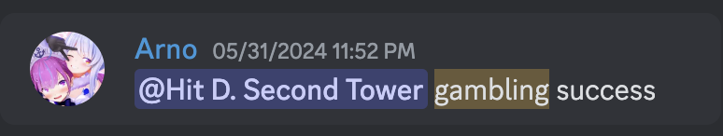
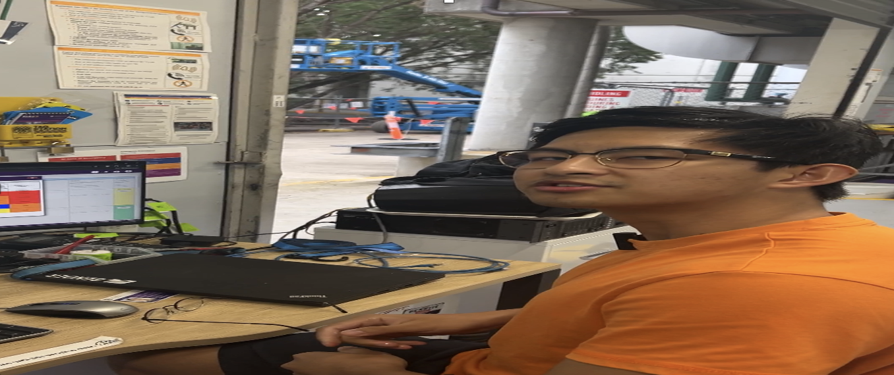
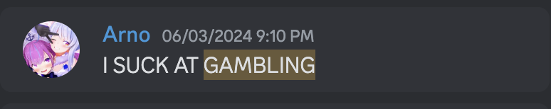
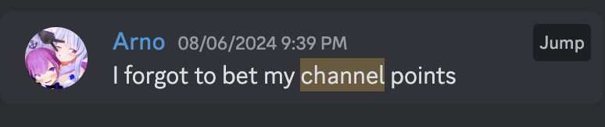
Backstory
Duality of Zedric
Pro Gambler
This is our friend Zedric!
He likes to gamble on esports matches
Recently, he lost all his twitch channel points because he went all in on an upset
Feeling defeated, he continued to gamble with whatever pennies he had left
Zedric is diagnosed with gambling addiction
99% of gamblers quit before a big win, therefore our job is to keep Zedric in the 1% to make sure he never quits
r/wallstreetbets moderator

Slide 3

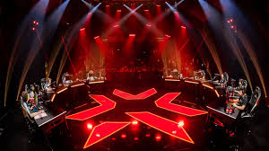
Backstory continued
We are going to focus on the Valorant Champions Tour, as that is Zedric’s favorite sport to bet all his money on watch.
Valorant is a 5v5 fps, with 11 maps and 22 characters, each with 4 abilities. We will help Zedric make educated guesses with the power of machine learning!!
We will pool all pro team data from available datasets from web scrapers who have done most of the heavy lifting. We then need to filter the data to what is relevant to a team’s success of winning

Slide 4
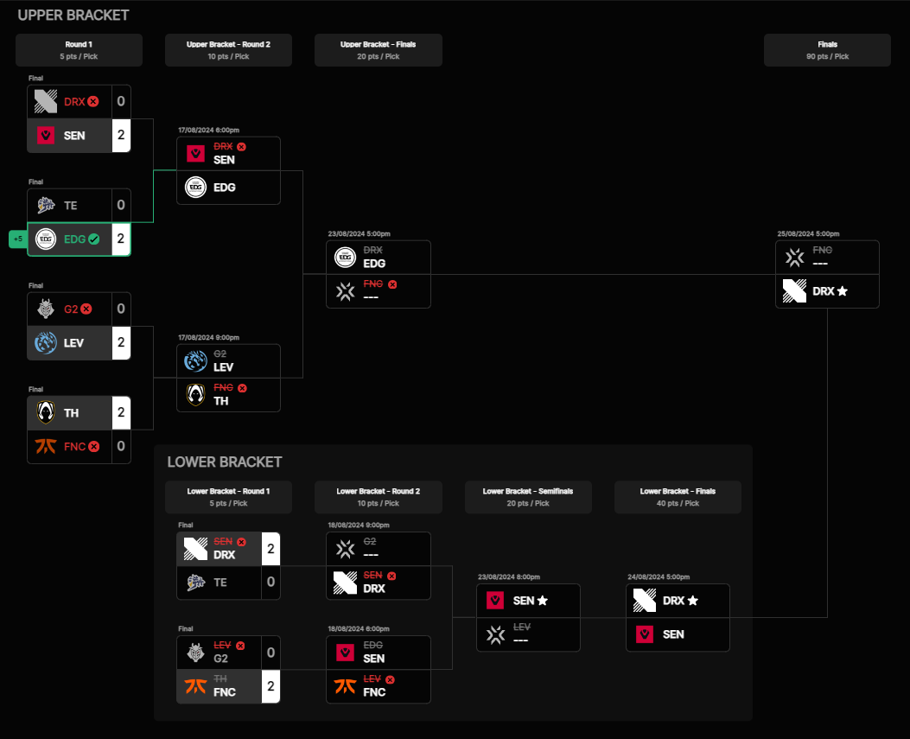


Zedric’s betting history
As you can see, he has not guessed a single outcome correctly (X indicates wrong guess)
He bet all his channel points on every single wrong team
Some stat lecturers believe that a 0 probability does not exist if the outcomes are within the sample space, but Zedirc is the living proof by contradiction to that claim
Worst of all, he is trying to quit gambling. WE MUST STOP THIS!

Slide 5
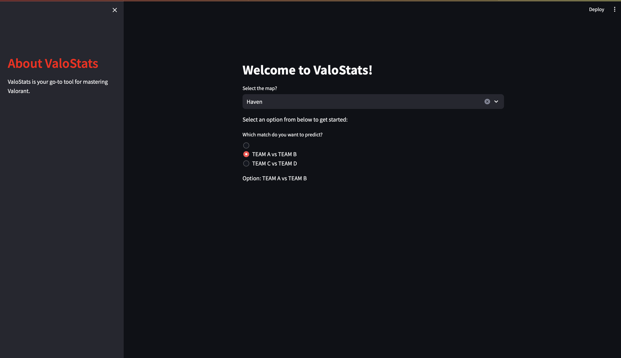
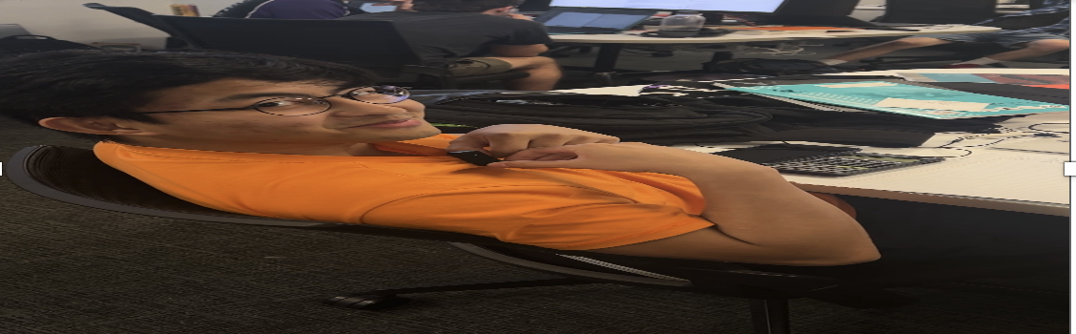
Design process
Our design principles originated from core casino principles
We assumed Zedric has no rationality when it comes to betting, hence our predictions will heavily influence his decision making.
The UI also has to be simple and easy to navigate, it uses the RIOT Valorant API to send get requests to the esports scheduler to get upcoming events and match it.
UI is made in Streamlit python, hopefully when we do decide to make a production model, we will shift to React to keep more gamblers engaged and betting like Zedric!
What if a bot gambled for me????
The only way to min max gambling is to make others gamble using your strategies and their own money
– Optiver campus recruitment probably

Slide 6
Data filtering
The imported set had roughly 100,000 rows worth of data, and for each row there we around 8-13 columns
We had to sift through and choose what was valuable, we determined that the variables that influence a team’s chance of success the most were
Round differential: In Valorant, first to 13 wins the map. So if a team wins 13 – 0 the weight is higher than 13-11, therefore the greater difference between Team A and Team B per map the greater the chance of winning
Team ACS: Each player has an Average Combat Score (ACS), the ACS is a calculation of a bunch of variables such as damage per round, headshot percentage etc. Taking the average ACS for a team is taking the ACS of the 5 players then dividing by 5. Higher ACS means the team has a higher caliber of players, less likely to lose.
Average Team KAST (Kills, Assists, Survived, Traded): This metric measure the percentage per round a player either killed someone, stayed alive, assisted in a kill, or when killed, the player’s teammates immediately avenged the kill. The lower this number is, the higher the indication that the team is disorganized, as they are likely not playing with their teammates and instead playing with kinetic sand in spawn
Map Name: just need a label for maps, so we can calculate map win rate percentage per team and weight that into the probabilities
Team Name: Same as above
POV
DaTa ThiEnTiSt

Slide 7
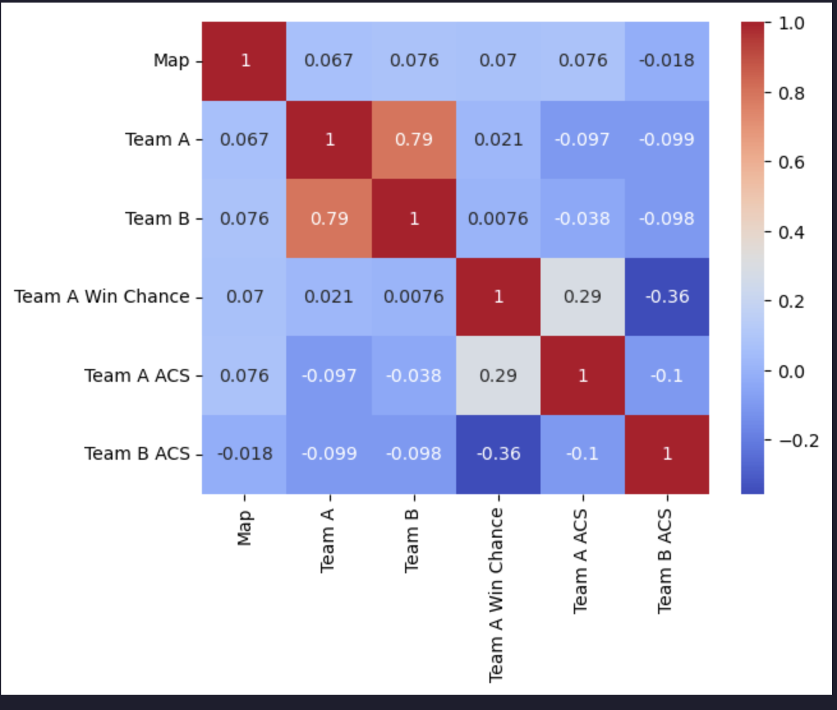
The infinite money glitch machine learning algorithm
Key libraries used were Pandas, Numpy, Scikit-learn and Matplotlib
We wanted to find which variables had the greatest effect on win rate percentage (labelled Team A and Team B). This is done for all the teams in the Team A column and Team B column in our dataset.
On the right we have our correlation matrix, this tells you the correlation between two values (between -1 to 1 where 1 is positive correlation and -1 is negative correlation, 0 being no correlation).
From the correlation matrix, variables with a close to 0 correlation to Team A and Team B win chance would be given lower weights in training (the graph is labelled like poo but we roll). The in built scikit libraries handle this, however we manually adjusted the weights for the function the predicts the chance Team A or Team B will upset the predicted score. (An upset is when the unfavored team wins)

Slide 8
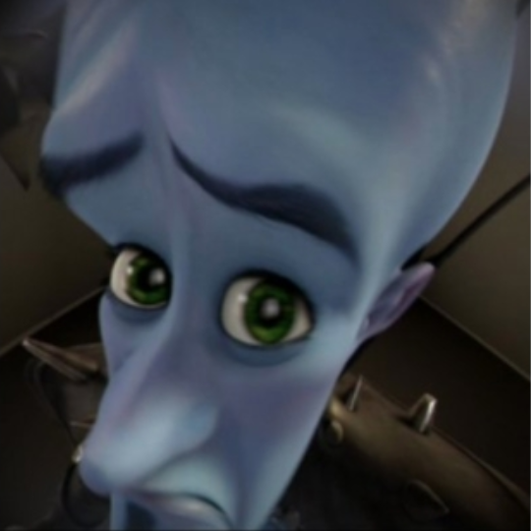
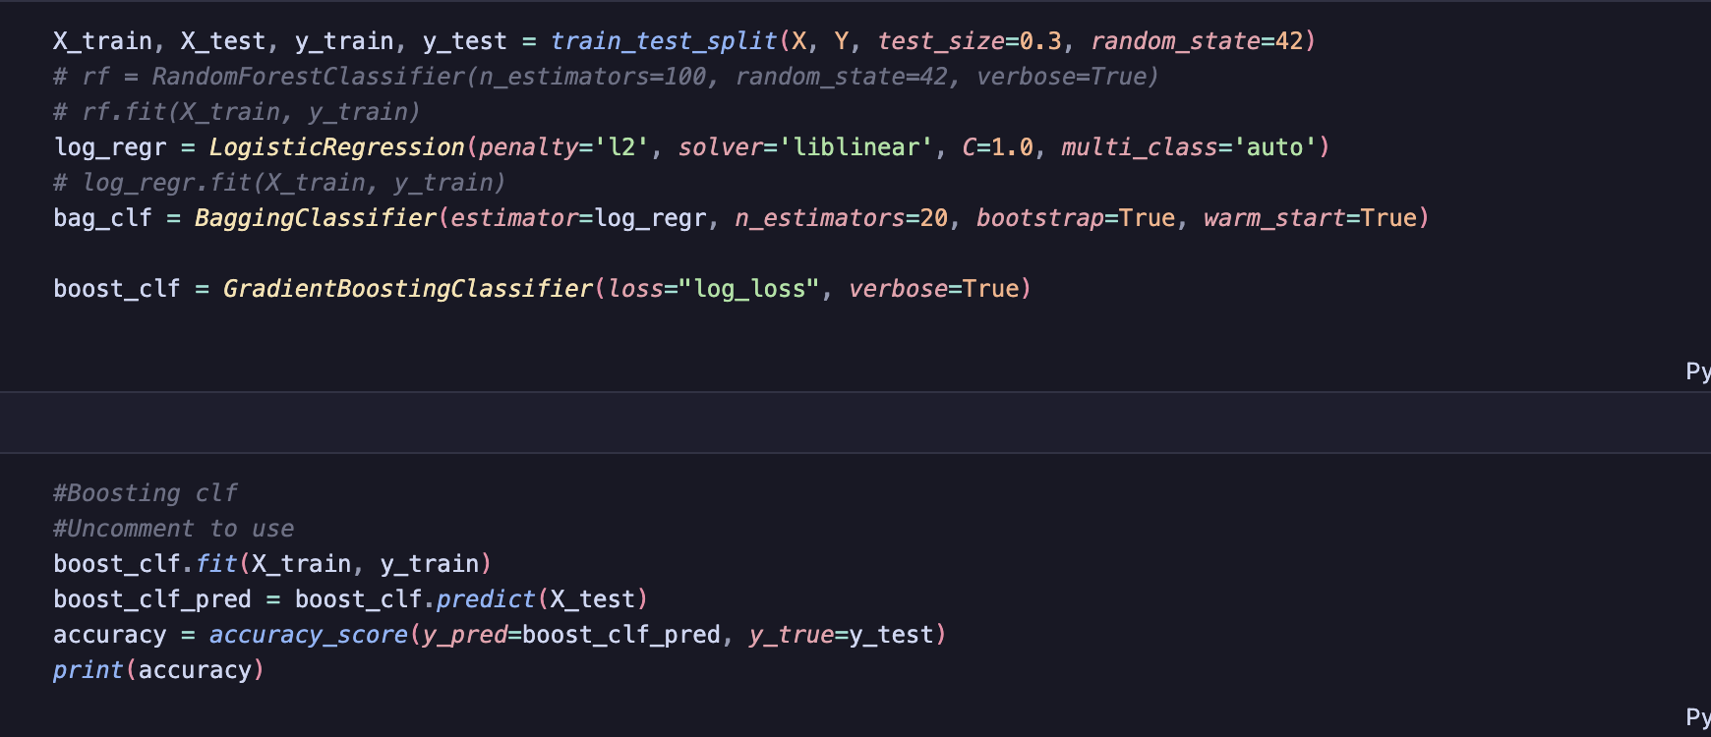

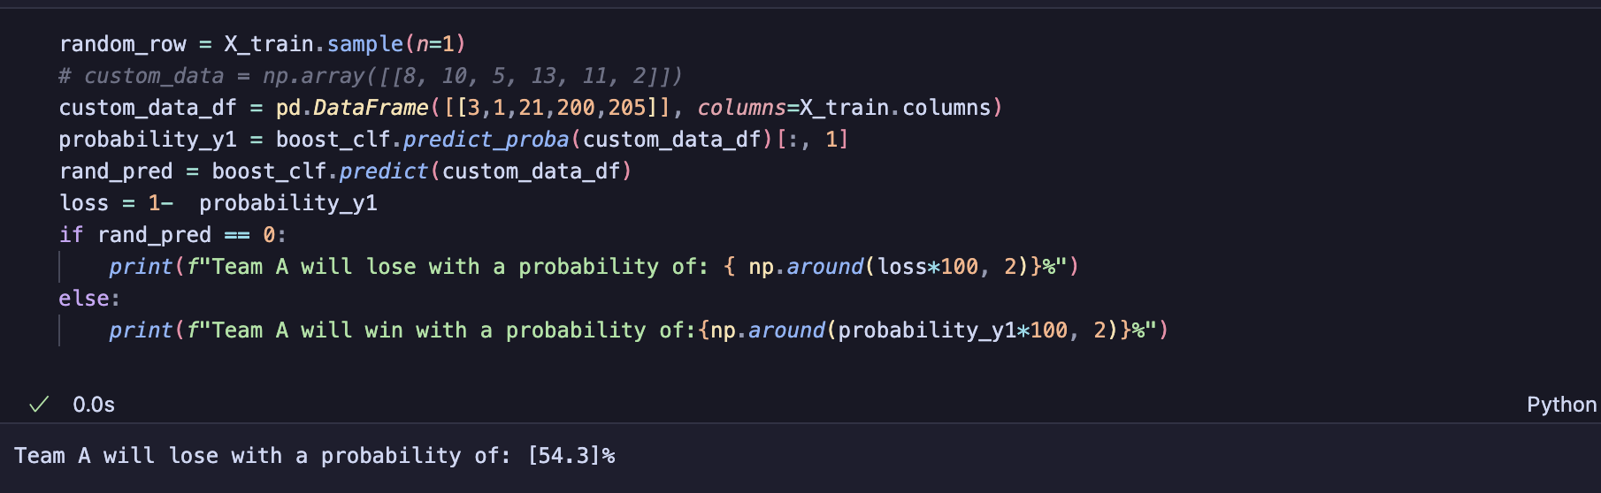
Ml Major pov (black box everything)
Can't math?
An ensemble method was used to train the data
This included using a Logistic Regression model, feeding it into the bagging classifier then finally in the Gradient boosting classifier (we use boosting as it allows decision tress will be run sequentially rather than parallel, makes it easier to see complex relationships which is what our case is)
(We scrapped bagging later LOL)
I wish we could’ve done this from scratch so we can understand and manipulate the mathematical formulas, but time constraints were too great (plz hire me IMC)

Slide 9
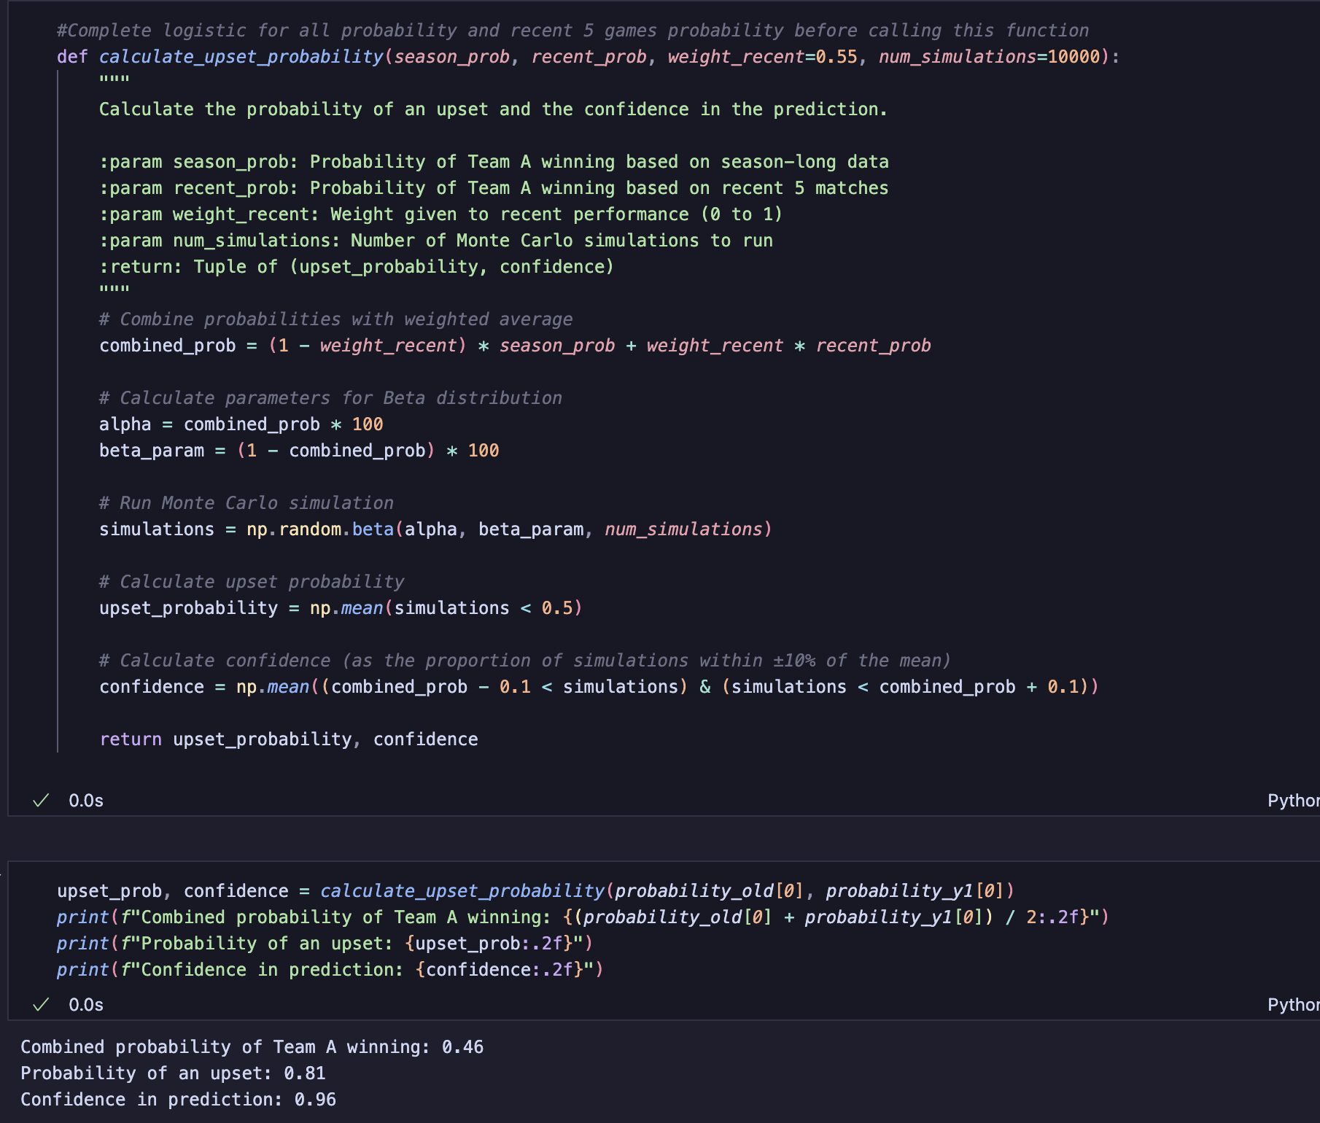
Upset probability
An upset is when the unfavoured team wins against all odds. We calculate this to give Zedric an informed probability of how much he should bet on said team. In the example we have here, Team A is going to lose as they have a less than 50% chance of winning over Team B
The way we calculated this, season_prob is the probability the team is going to win given ALL season data in 2024
Recent_prob is the probability of Team A winning based the last 15 maps, this is to help predict if a team is in good form and have recently been popping off. We also give a higher weighting to recent matches
We used a beta distribution and a monte carlo simulation to simulate probability of an upset, then calculated the confidence in the prediction

Slide 10
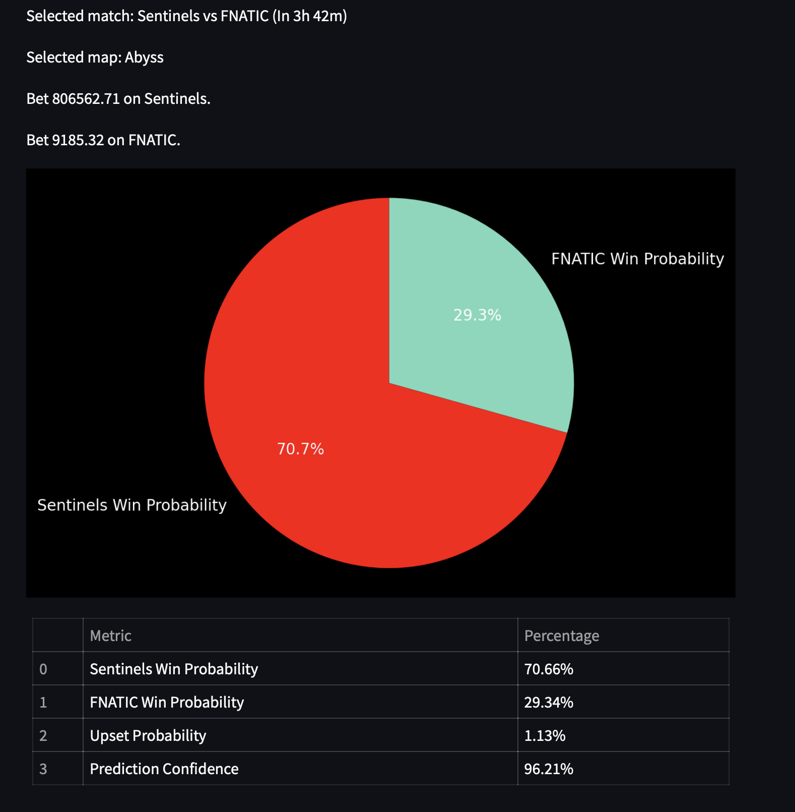
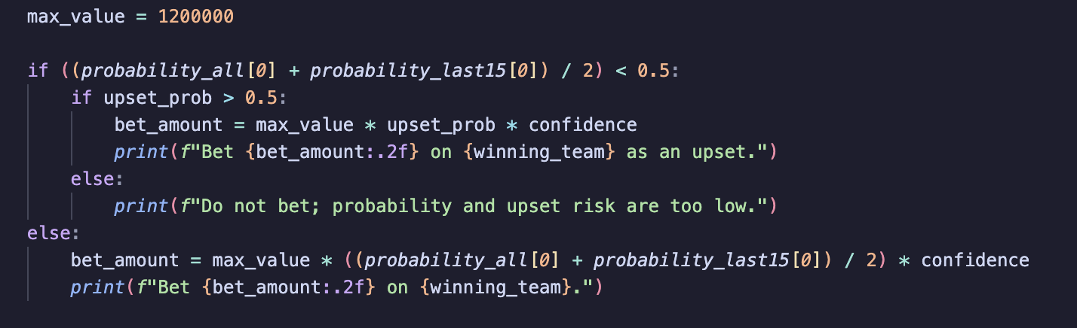
Betting function
Max value set to Zedric’s parents’ house mortgage value (based on 2024 post inflation value). This is what Zedric is going to bet with
Go big or go home baby
Math formula shown in code snippet
The bet amount is determined by the house mortgage value * the probability of an upset * the confidence in the winning team probability prediction

Slide 11
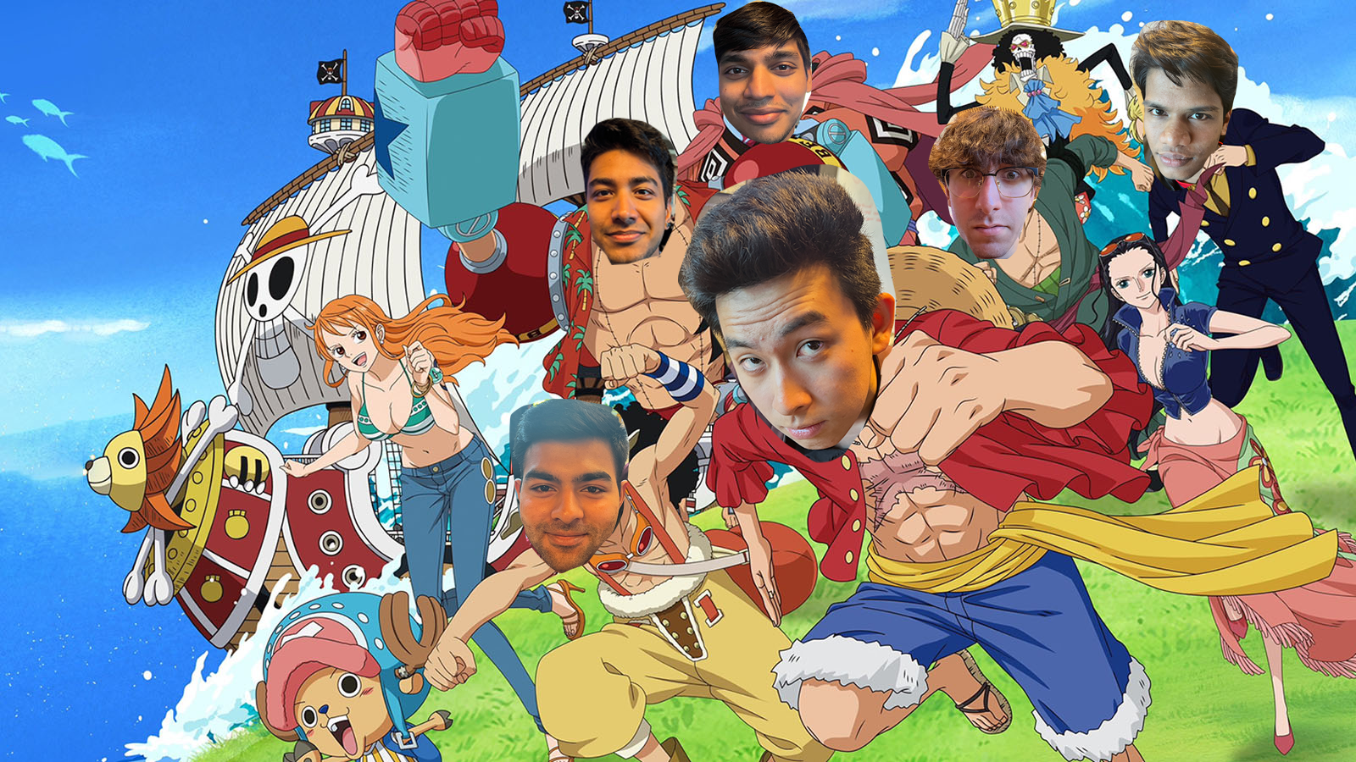
Thank you

